Slide 1



Our Solution
Phase 1
Crowd Detection
Phase 2
Crowd Control
Phase 3
Crowd Elimination

Slide 2

Crowd
Detection
by Face Detection

Slide 3

Face Detection
1
2
3
Real-time info on crowd density
Track crowd movement
Identify busy periods & branches

Slide 4
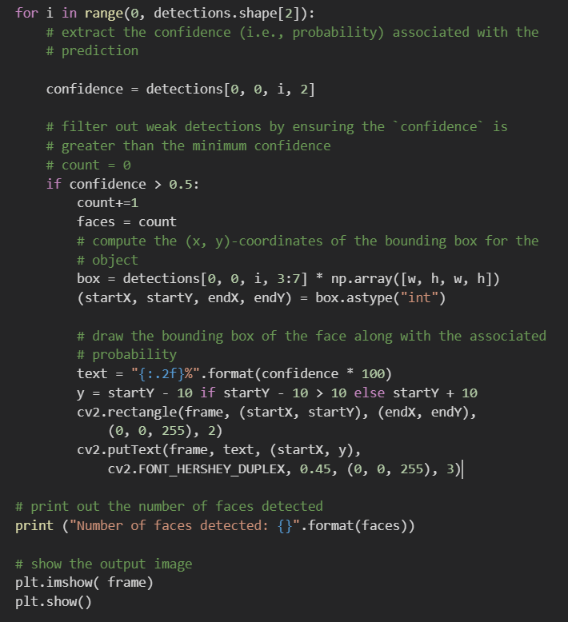
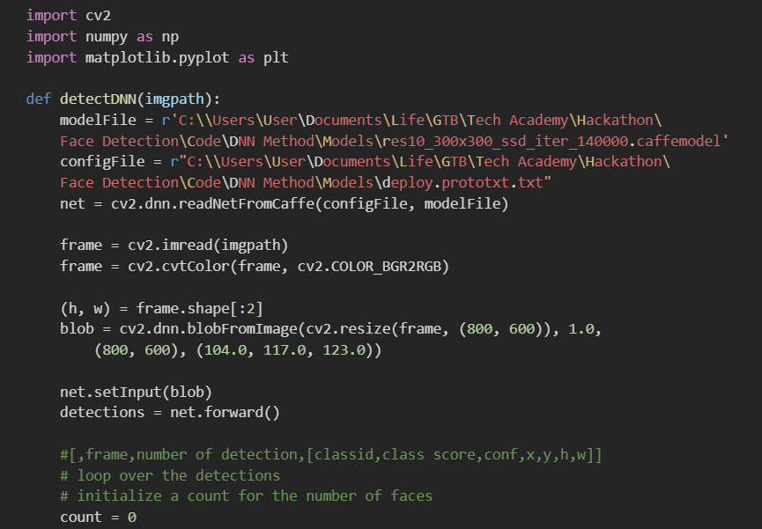
Our Code
Deep learning based face detector in OpenCV

Slide 5
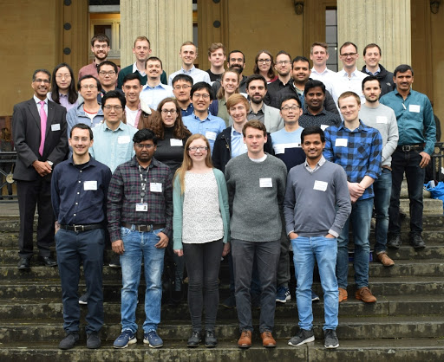
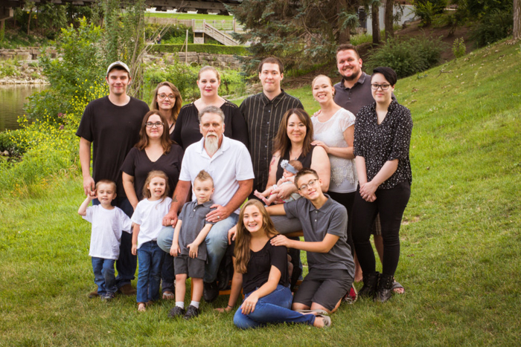
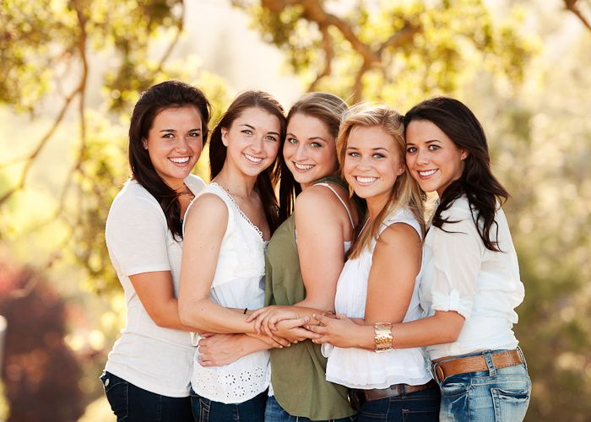
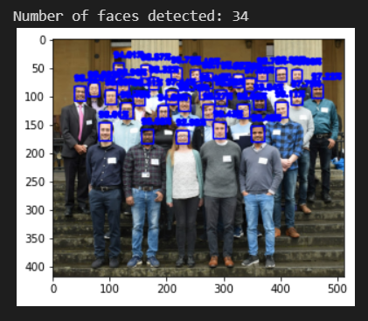
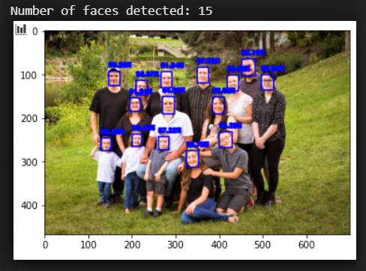
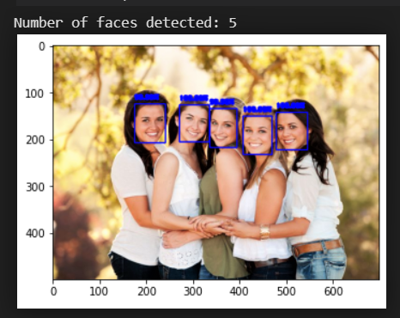
Our Results

